Slide 1


Nigeria Meningitis Outbreak Analysis
Data Science Final Project

Slide 2


OUTLINE
Introduction
Problem Description
Methodology
Source of Dataset
Visualization
Objective
Conclusion

Slide 3

INTRODUCTION

Slide 4
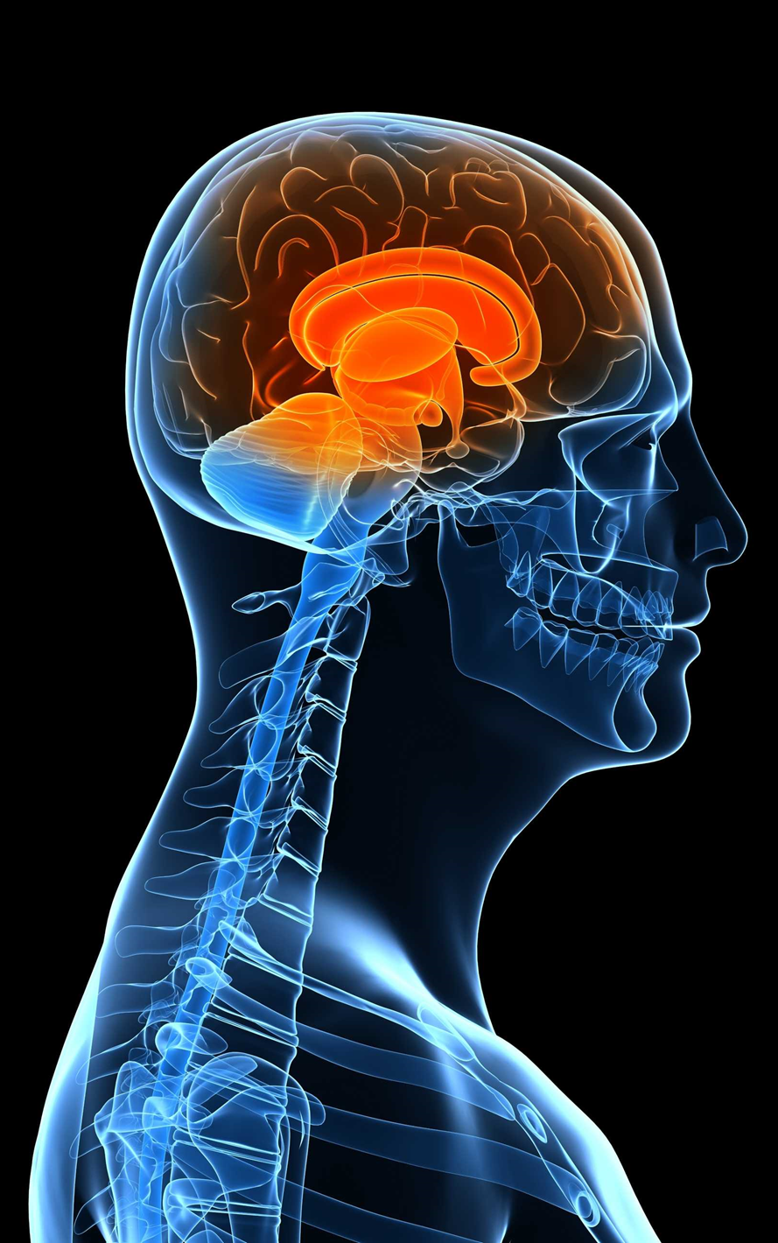

What is Meningitis
?

Slide 5





SYMPTOMS

Slide 6

METHODOLOGY
Sourcing of Data
Importing of Data
Cleaning of Data
Data Visualization
Feature Engineering
Data Analysis
Recommendation

Slide 7
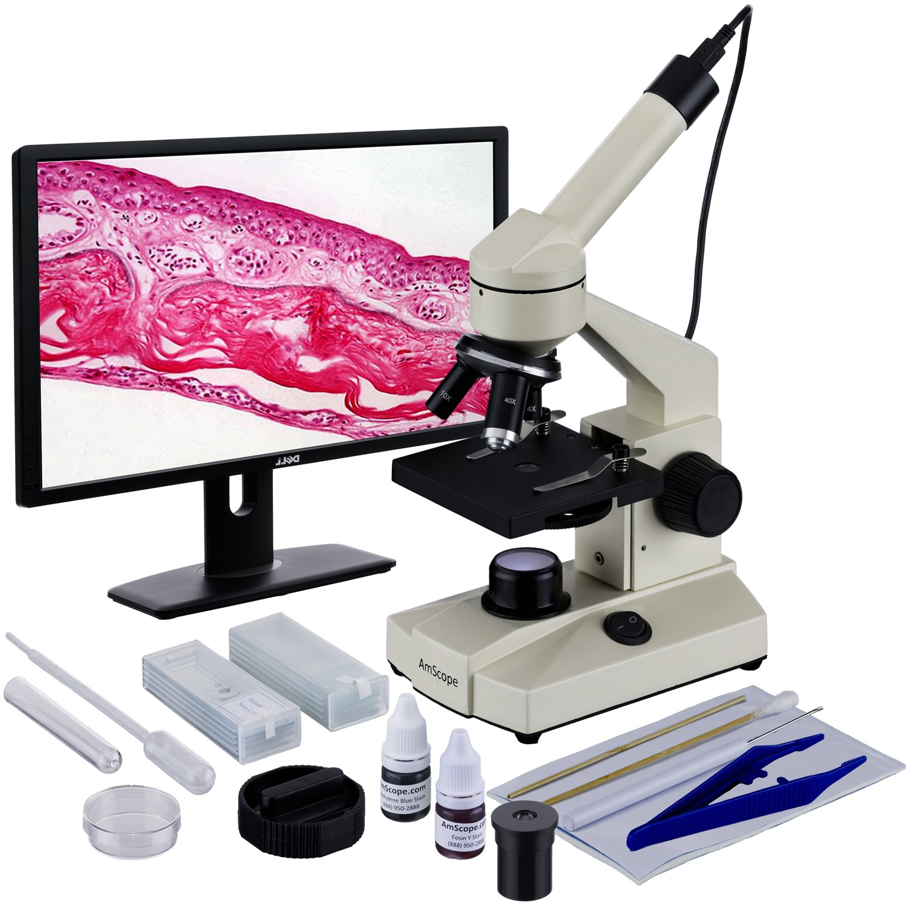

DATA SOURCE

Slide 8

OUR
VISUALISATION

Slide 9
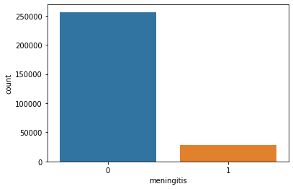
Chart showing people with and without Meningitis in the dataset

Slide 10
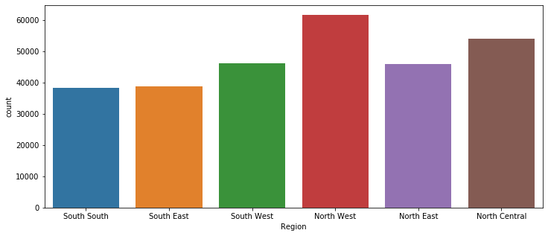
Meningitis concentration in every region

Slide 11
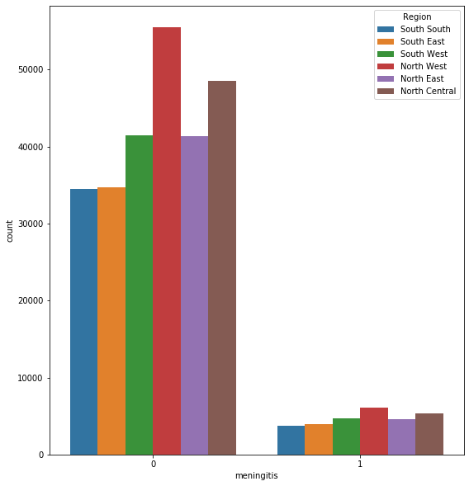
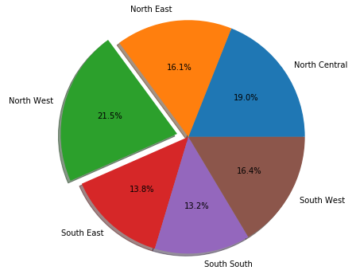
This chart shows the percentage concentration by regions

Slide 12
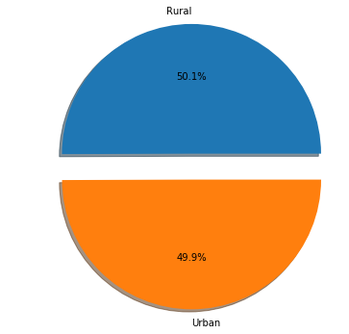
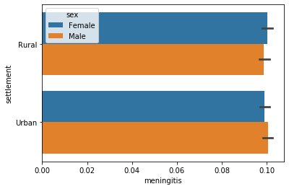
Meningitis percentage concentration by settlement

Slide 13
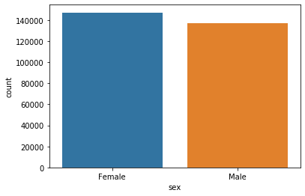
The gender distribution of our dataset

Slide 14
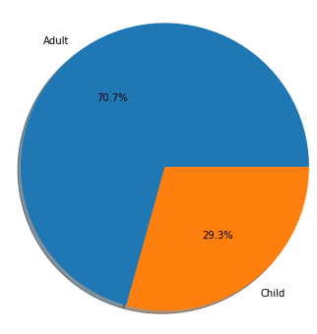
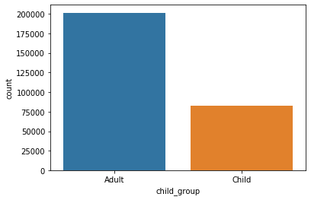
This shows the concentration between adults and children

Slide 15
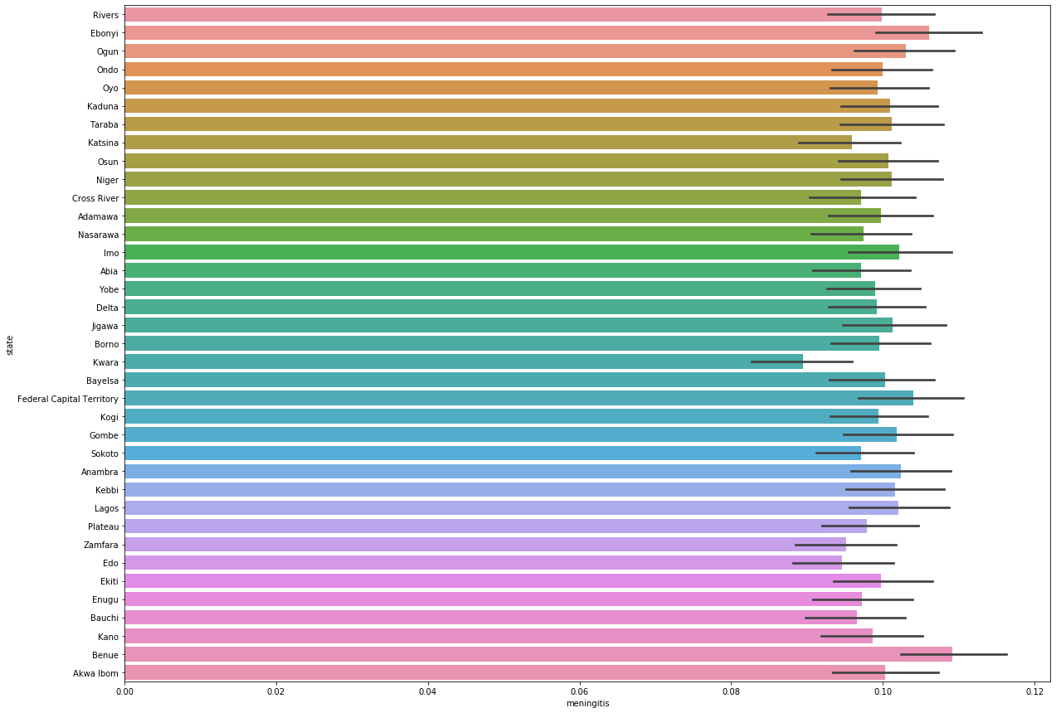
Meningitis concentration by States

Slide 16
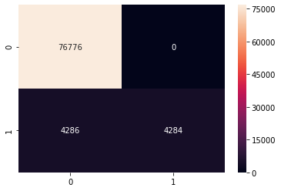
The confusion matrix
Machine Learning Accuracy 95%

Slide 17

Awareness Sensitization Availability of vaccines
OUR RECOMMENDATION

Slide 18

THANK YOU!

